Slide 1

Inverted Cone End Mill

Slide 2
Inverted Cone End Mill

Slide 3

Rounded End Mill

Slide 4
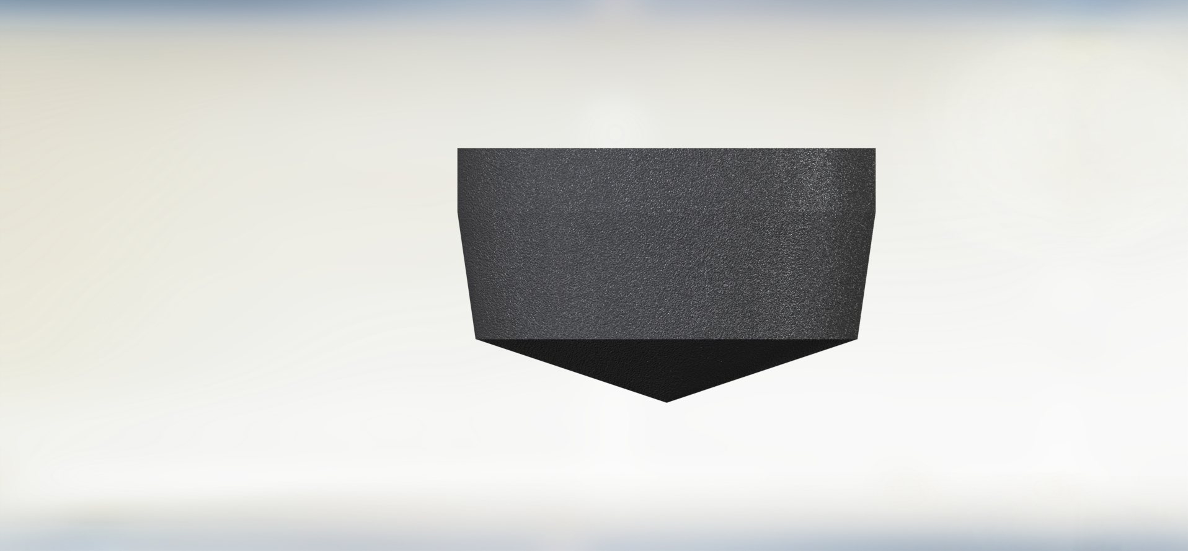
Cone End Mill

Slide 5

General End Mill

Slide 6

Taper Ball End Mill

Slide 7

Taper End Mill

Slide 8

Bull Nose End Mill

Slide 9

Cylindrical End Mill

Slide 10

Ball End Mill

